Slide 1
Improving Spark Performance
Chapter 20

Slide 2
Improving Spark Performance
In this chapter you will learn
How to improve performance of Spark programs using shared variables
Some common performance issues and how to find and address them

Slide 3
Chapter Topics
Improving Performance
Shared Variables: Broadcast Variables
Shared Variables: Accumulators
Common Performance Issues
Diagnosing Performance Problems
Essential Points
Hands-On Exercise: Using Broadcast Variables
Hands-On Exercise: Using Accumulators

Slide 4





Broadcast Variables
Broadcast variables are set by the driver and retrieved by the workers
They are read-only once set
The first read of a Broadcast variable retrieves and stores its value on the node
Driver Program
Executor
Executor
myVariable
Spark Master
Executor

Slide 5










Example: Match User IDs with Requested Page Titles
227.35.151.122 - 184 [16/Sep/2013:00:03:51 +0100] "GET /KBDOC-00183.html HTTP/1.0" 200 …
146.218.191.254 - 133 [16/Sep/2013:00:03:48 +0100] "GET /KBDOC-00188.html HTTP/1.0" 200 …
176.96.251.224 - 12379 [16/Sep/2013:00:02:29 +0100] "GET /KBDOC-00054.html HTTP/1.0” 16011…
…
logs
(184, KBDOC-00183)
(133, KBDOC-00188)
(12379, KBDOC-00054)
…
pages
(KBDOC-00001, |  | title1)
(KBDOC-00002, |  | title2)
(KBDOC-00003, |  | title3)
…
pagelogs
(184, title183)
(133, title188)
(12379, title54)
…
KBDOC-00001:MeeToo 4.1 - Back up files
KBDOC-00002:Sorrento F24L - Change the phone ringtone and notification sound KBDOC-00003:Sorrento F41L – overheating
…

Slide 6


Example: Join a Web Server Log with Page Titles
logs = sc.textFile(logfile).map(fn) pages = sc.textFile(pagefile).map(fn) pagelogs = logs.join(pages)
pages
join
pagelogs
logs

Slide 7











Example: Pass a Small Table as a Parameter
 | Language: Python
logs = sc.textFile(logfile).map(fn) pages = dict(map(fn,open(pagefile))) pagelogs = logs.map(lambda (userid,pageid): (userid,pages[pageid]))
logs
pagelog
s
task
Driver
task
pages
task
task
task task

Slide 8




Example: Broadcast a Small Table
Language: Python
logs = sc.textFile(logfile).map(…) pages = dict(map(fn,open(pagefile))) pagesbc = sc.broadcast(pages)
pagelogs = logs.map(lambda (userid, pageid): (userid,pagesbc.value[pageid])))
logs
pagelog
s
Driver
pages
pagesbc

Slide 9
Broadcast Variables
Why use Broadcast variables?
– Use to minimize transfer of data over the network, which is usually the biggest bottleneck
– Spark Broadcast variables are distributed to worker nodes using a very efficient peer-to-peer algorithm

Slide 10
Chapter Topics
Improving Performance
Shared Variables: Broadcast Variables
Shared Variables: Accumulators
Common Performance Issues
Diagnosing Performance Problems
Essential Points
Hands-On Exercise: Using Broadcast Variables
Hands-On Exercise: Using Accumulators
19-10

Slide 11




Accumulators
Accumulators are shared variables
Worker nodes can add to the value
Only the driver application can access the value
n
Driver Program
Executor
+
.set
.value
Executor
+
myAccumulator
Spark Master
Executor
+

Slide 12

Accumulator Example: Average Word Length
Example: Calculate the average length of all the words in a dataset
def addTotals(word,words,letters): words += 1
letters += len(word)
totalWords = sc.accumulator(0) totalLetters = sc.accumulator(0.0)
words = sc.textFile(myfile) \
.flatMap(lambda line: line.split())
words.foreach(lambda word: \ addTotals(word,totalWords,totalLetters))
print "Average word length: ", \ totalLetters.value/totalWords.value

Slide 13
More About Accumulators
Accumulators will only be incremented once per task
If tasks must be rerun due to failure, Spark will correctly add only for the task which succeeds
Only the driver can access the value
Updates are only sent to the master, not to all workers
– Code will throw an exception if you use .value on worker nodes
Supports the increment (+=) operator
Can use integers or doubles
sc.accumulator(0)
sc.accumulator(0.0)
Can customize to support any data type
Extend the AccumulatorParam class

Slide 14
Chapter Topics
Improving Performance
Shared Variables: Broadcast Variables
Shared Variables: Accumulators
Common Performance Issues
Diagnosing Performance Problems
Essential Points
Hands-On Exercise: Using Broadcast Variables
Hands-On Exercise: Using Accumulators

Slide 15
Performance Issue: Serialization
Serialization affects
Network bandwidth
Memory (save memory by serializing)
Default method of serialization in Spark is basic Java serialization
Simple but slow

Slide 16


Solution: Use Kryo Serialization
Use Kryo serialization for Scala and Java
To enable, set spark.serializer = spark.KryoSerializer
To enable Kryo for your custom classes
Create a KryoRegistrator class and set spark.kryo.registrator=MyRegistrator
Register your classes with Kryo
Language: Scala
class MyRegistrator extends spark.KryoRegistrator { def registerClasses(kryo: Kryo) { kryo.register(classOf[MyClass1]) kryo.register(classOf[MyClass2])
…
}
}

Slide 17




Performance Issue: Small Partitions
Problem: filter() can result in partitions with small amounts of data
– Results in many small tasks
Language: Python
sc.textFile(file) \
.filter(lambda s: s.startswith('I')) \
.map(lambda s: \ (s.split()[0],(s.split()[1],s.split()[2])))
RDD
RDD

Slide 18

Solution: Repartition/Coalesce
Solution: repartition(n)
– This is the same as coalesce(n, shuffle=true)
Language: Python
sc.textFile(file) \
.filter(lambda s: s.startswith('I')) \
.repartition(3) \
.map(lambda s: \ (s.split()[0],(s.split()[1],s.split()[2])))
RDD
RDD
RDD

Slide 19


Performance Issue: Passing Too Much Data in Functions
Problem: Passing large amounts of data to parallel functions results in poor performance
Language: Python
hashmap = some_massive_hash_map()
…
myrdd.map(lambda x: hashmap(x)).countByValue()

Slide 20



Solution: Broadcast or Parallelize
Solution:
– If the data is relatively small, use a Broadcast variable
hashmap = some_massive_hash_map() bhashmap = sc.broadcast(hashmap)
…
myrdd.map(lambda x: bhashmap(x)).countByValue()
– If the data is very large, parallelize into an RDD
hashmap = some_massive_hash_map() hashmaprdd = sc.parallelize(hashmap)
… myrdd.join(bhashmaprdd).countByValue()
19-20

Slide 21

Performance Issue: Sending Whole Objects
In Scala, when referencing a function or variable in an operation, the entire enclosing scope is serialized
– This may result in unintentionally passing too much data across the network
object MyVeryLargeObject { val LotsOfData…
def usefulFunction(…) {…}
}
sc.textFile(file) \
.map(s => MyVeryLargeObject.usefulFunction(s))…
Solution: Use a broadcast variable if necessary

Slide 22








Performance Issue: Skewed Data
A few workers may be handling a disproportionate amount of data
The problem: data is not evenly distributed by key
Solution: custom partitioning
Partition 0
Partition 1
Partition 2
Partition 3

Slide 23
Chapter Topics
Improving Performance
Shared Variables: Broadcast Variables
Shared Variables: Accumulators
Common Performance Issues
Diagnosing Performance Problems
Essential Points
Hands-On Exercise: Using Broadcast Variables
Hands-On Exercise: Using Accumulators

Slide 24

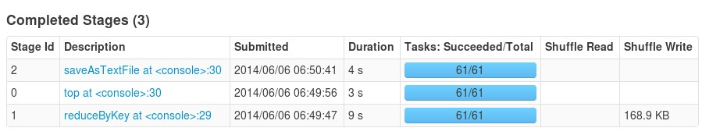

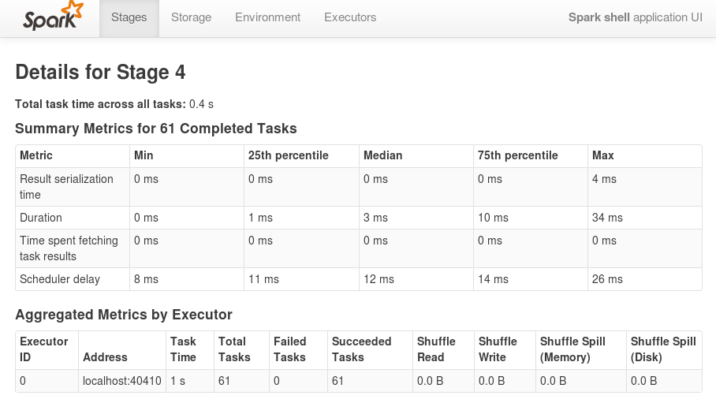

Diagnosing Performance Issues (1)
The Spark Application UI provides useful metrics to find performance problems
Stage Details

Slide 25
Diagnosing Performance Issues (2)
Where to look for performance issues
Scheduling and launching tasks
Task execution
Shuffling
Collecting data

Slide 26

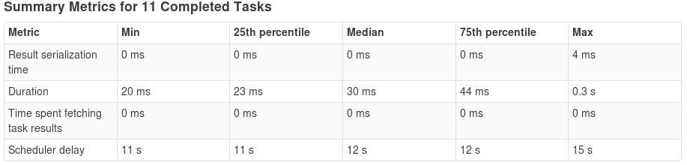
Scheduling and Launching Issues
Scheduling and launching taking too long
– Are you passing too much data to tasks?
– myrdd.map(lambda
x: HugeLookupTable(x))
– Use a broadcast variable or an RDD

Slide 27
Task Execution Issues (1)
Task execution taking too long?
Are there tasks with a very high per-record overhead?
For example mydata.map(dbLookup)
Each lookup call opens a connection to the DB, reads, and closes
Try mapPartitions

Slide 28




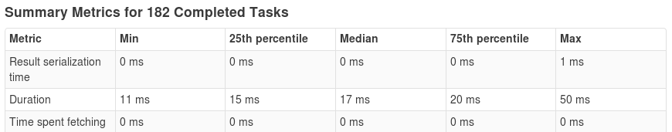

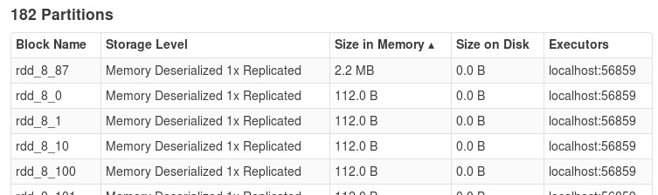

Task Execution Issues (2)
Are a few tasks taking much more time than others?
– Repartition, partition on a different key, or write a custom partitioner
Task durations should be fairly even
Example: empty partitions due to filtering

Slide 29



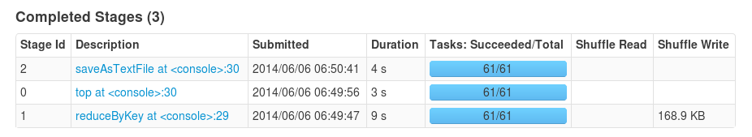






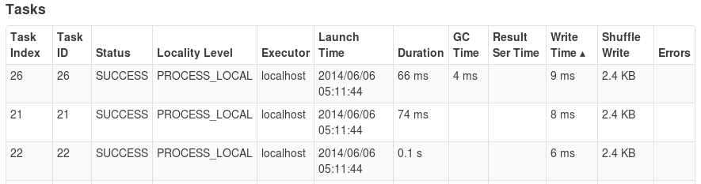

Shuffle Issues
Writing shuffle results taking too long?
Make sure you have enough memory for buffer cache
Make sure spark.local.dir is a local disk, ideally dedicated
Saves to disk if too big for buffer cache

Slide 30




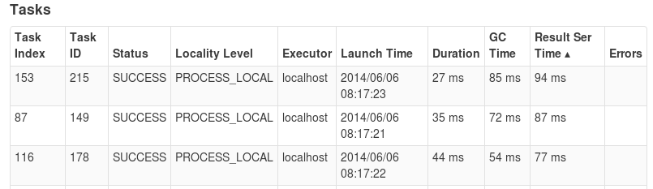

Collecting Data to the Driver
Are results taking too long?
– Beware of returning large amounts of data to the driver, for example with collect()
Process data on the workers, not the driver
Save large results to HDFS
Watch for disproportionate result serialization times
19-30

Slide 31
Performance Analysis and Monitoring
Spark supports integration with other performance tools
Configurable metrics system built on the Coda Hale Metrics Library
Metrics can be
Saved to files
Output to the console
Viewed in the JMX console
Sent to reporting tools like Graphite or Ganglia

Slide 32
Chapter Topics
Improving Performance
Shared Variables: Broadcast Variables
Shared Variables: Accumulators
Common Performance Issues
Diagnosing Performance Problems
Essential Points
Hands-On Exercise: Using Broadcast Variables
Hands-On Exercise: Using Accumulators

Slide 33
Essential Points
Network bandwidth is often the major bottleneck
For best performance, minimize data shuffling between workers
Broadcast variables allow you to copy data to each worker once
– Use instead of an RDD for small datasets
Accumulators allow workers to update a shared variable locally
Use Kryo serialization instead of default Scala/Java serialization to speed up network copy of data, and save memory
Repartition to avoid unbalanced or very small partitions across nodes

Slide 34
Chapter Topics
Improving Performance
Shared Variables: Broadcast Variables
Shared Variables: Accumulators
Common Performance Issues
Diagnosing Performance Problems
Essential Points
Hands-On Exercise: Using Broadcast Variables
Hands-On Exercise: Using Accumulators

Slide 35
Hands-On Exercises
Hands-On Exercise: Using Broadcast Variables
Filter web server logs for requests from selected devices
Use a broadcast variable for the list of target device models to filter
Hands-On Exercise: Using Accumulators
Use Accumulator variables to count the number of requests for different types of files in a set of web server logs
Please refer to the Hands-On Exercise Manual

Slide 36



Git, Nexus, sbt and Maven
Chapter 21

Slide 37
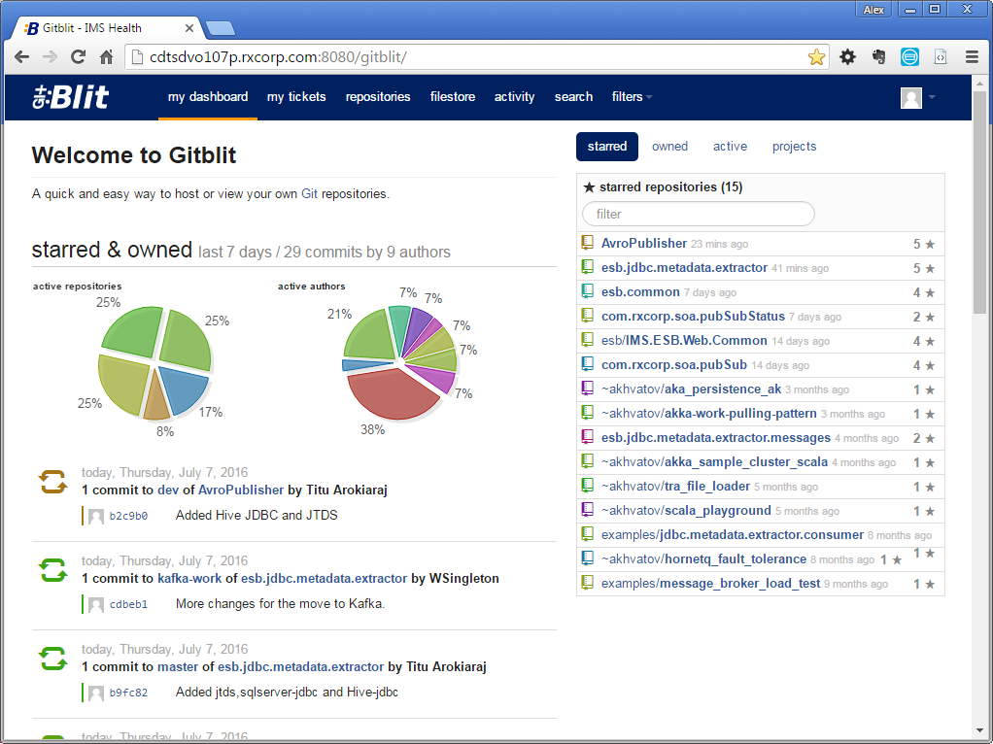
Git Fundamentals
Distributed Version Control System (DVCS)
Meant to be distributed, fast and more natural
Capable of handling large projects
Git @ IMS Health
http://cdtsdvo107p.rxcorp.com:8080/gitblit

Slide 38
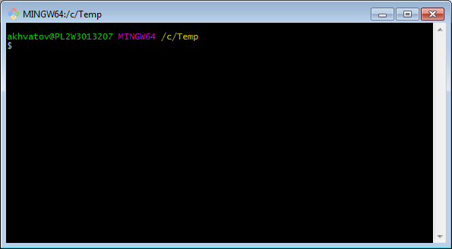
Working with Git
Command line interface
Many GUI tools available
Official Git site – http://git-scm.com

Slide 39
Git Help
$ git help
usage: git [--version] [--help] [-C <path>] [-c name=value]
[--exec-path[=<path>]] [--html-path] [--man-path] [--info-path]
[-p | --paginate | --no-pager] [--no-replace-objects] [--bare]
[--git-dir=<path>] [--work-tree=<path>] [--namespace=<name>]
<command> [<args>]
These are common Git commands used in various situations:
start a working area (see also: git help tutorial)
clone Clone a repository into a new directory
init Create an empty Git repository or reinitialize an existing one
work on the current change (see also: git help everyday)
add Add file contents to the index
mv Move or rename a file, a directory, or a symlink
reset Reset current HEAD to the specified state
rm Remove files from the working tree and from the index
examine the history and state (see also: git help revisions)
bisect Use binary search to find the commit that introduced a bug

Slide 40
Git Help
$ git help config
git-config(1) Manual Page
NAME
git-config - Get and set repository or global options
SYNOPSIS
git config [<file-option>] [type] [-z|--null] name [value [value_regex]]
git config [<file-option>] [type] --add name value
git config [<file-option>] [type] --replace-all name value [value_regex]

Slide 41
Setting up Git
$ git config –global user.name “Alex Khvatov”
$ git config –global user.email akhvatov@us.imshealth.com
$ git config –global color.ui true

Slide 42
Starting a repo
$ mkdir projectA
$ cd projectA
$ git init
Initialized empty Git repository in C:/Temp/projectA/.git/
git metadata is stored here

Slide 43
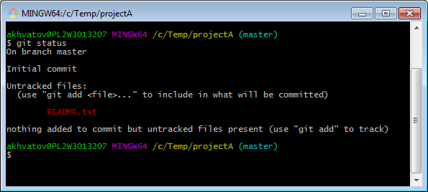
Working with Git
User creates README.txt file

Slide 44
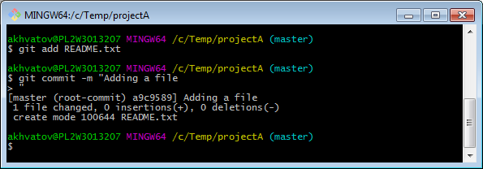
Working with Git
Add file to staging area
Commit changes
User adds another file – LICENSE.txt and modifies README.txt
Add both files to staging area
Commit changes

Slide 45
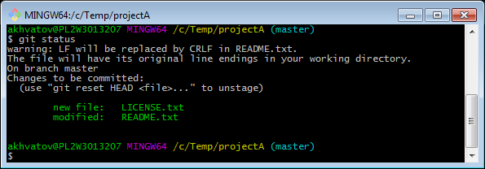
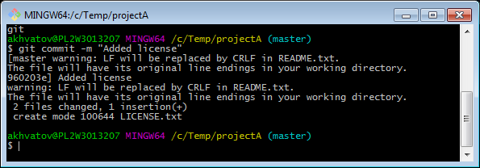
Working with Git

Slide 46
Comitting
Adding files
$ git add <list of files>
$ git add –all
$ git add *.txt
$ git add projectDir/
$ git add “*.txt”
$ git commit –m “message”
$ git commit –am “message”
$ git commit

Slide 47
Sharing code: Working with remote repository
Create a new repository in GitBlit
Follow the instructions on how to add a reference to the remote repository
Push changes to the remote repository
Pull changes made to the remote repository to keep up-to-date
Clone existing repository from GitBlit
Make changes to files
Push changes to the remote repository

Slide 48
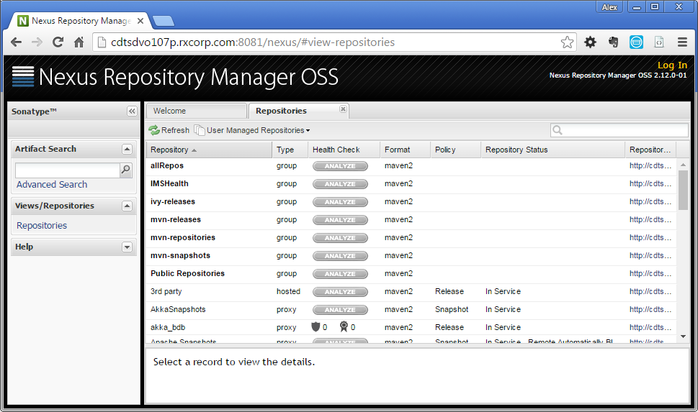
Nexus
Used for internal artifact management
Proxy external repositories; inaccessible due to IMS Health firewall restrictions.

Slide 49
SBT (Simple Build Tool)
De-facto build tool used for Scala development

Slide 50
Maven
Java project lifecycle management application
Create a project:
$mvn archetype:generate -DgroupId=com.mycompany.app \
-DartifactId=my-app \
-DarchetypeArtifactId=maven-archetype-quickstart \
-DinteractiveMode=false

Slide 51
Maven
The POM
<project xmlns="http://maven.apache.org/POM/4.0.0" xmlns:xsi="http://www.w3.org/2001/XMLSchema-instance"
xsi:schemaLocation="http://maven.apache.org/POM/4.0.0 http://maven.apache.org/xsd/maven-4.0.0.xsd">
<modelVersion>4.0.0</modelVersion>
<groupId>com.mycompany.app</groupId>
<artifactId>my-app</artifactId>
<version>1.0-SNAPSHOT</version>
<packaging>jar</packaging>
<name>Maven Quick Start Archetype</name>
<url>http://maven.apache.org</url>
<dependencies>
<dependency>
<groupId>junit</groupId>
<artifactId>junit</artifactId>
<version>4.8.2</version>
<scope>test</scope>
</dependency>
</dependencies>
</project>

Slide 52
Maven
Most common default lifecycle phases:
validate: validate the project is correct and all necessary information is available
compile: compile the source code of the project
test: test the compiled source code using a suitable unit testing framework. These tests should not require the code be packaged or deployed
package: take the compiled code and package it in its distributable format, such as a JAR.
integration-test: process and deploy the package if necessary into an environment where integration tests can be run
verify: run any checks to verify the package is valid and meets quality criteria
install: install the package into the local repository, for use as a dependency in other projects locally
deploy: done in an integration or release environment, copies the final package to the remote repository for sharing with other developers and projects.

Slide 53
Maven
There are two other Maven lifecycles of note beyond the default list above. They are
clean: cleans up artifacts created by prior builds
site: generates site documentation for this project
Phases are actually mapped to underlying goals. The specific goals executed per phase is dependant upon the packaging type of the project. For example, package executes jar:jar if the project type is a JAR, and war:war if the project type is - you guessed it - a WAR.
An interesting thing to note is that phases and goals may be executed in sequence.
$ mvn clean dependency:copy-dependencies package

Slide 54
Maven
Build the Project
$ mvn clean package

Slide 55
Conclusion
Chapter 22

Slide 56
Conclusion (1)
During this course, you have learned
The purpose of Hadoop and its related tools
The features that Hive and Impala offer for data acquisition, storage, and analysis
How to identify typical use cases for large-scale data analysis
How to load data from relational databases and other sources
How to manage data in HDFS and export it for use with other systems
How Hive and Impala improve productivity for typical analysis tasks
The language syntax and data formats supported by these tools
How to design and execute queries on data stored in HDFS
How to join diverse datasets to gain valuable business insight
How Hive and Impala can be extended with custom functions and scripts
21-2

Slide 57
Conclusion (2)
How to analyze structured, semi-structured, and unstructured data
How to store and query data for better performance
What Apache Spark is and why you would want to use it
The basic programming concepts of Spark: operations on Resilient Distributed Datasets (RDDs)
How Spark works to distribute processing of big data across a cluster
How Spark interacts with other components of a big data system
How to take advantage of key Spark features to improve performance
How to use Spark – either interactively using a Spark Shell or by writing your own Spark Applications
How to use Spark SQL to work with structure data as tables

Slide 58
Which Course to Take Next?
Cloudera offers a range of training courses for you and your team
For developers
Cloudera Developer Training for Apache Hadoop
Designing and Building Big Data Applications
Cloudera Training for Apache HBase
For system administrators
Cloudera Administrator Training for Apache Hadoop
For data scientists
Data Science at Scale with Spark and Hadoop
For architects, managers, CIOs, and CTOs
Cloudera Essentials for Apache Hadoop

